Slide 1
Session 05
Interface and Inheritance
(https://docs.oracle.com/javase/tutorial/java/IandI/)
Session 05 - Interface and Inheritance

Slide 2
Objectives
Benefits of OO implementation: Inheriatnce, Polymorphism
Working with Interfaces.
Working with Abstract Methods and Classes.
Anonymous Classes
Enum Type
Practice walkthroughs
Session 05 - Interface and Inheritance

Slide 3
Implementing
Object-Oriented Relationships
3 common relations in classes:
  “is a/ a kind of”
  “has a”
  association
Examples:
  Student is a person
  “A home is a house that has a family and a pet.”
  An invoice contains some product and a products can be contained in one invoice
Session 05 - Interface and Inheritance

Slide 4
Implementing
Object-Oriented Relationships…
The relation “is a” is implemented as a sub-class
Person
String name, address String birthDate
+ String getName(); + void setName(String n);
…….
The relation “has a” is implemented as reference
Classes Professor, Student are sub-classes of the class Person
Sub-classes inherit the structure of super class
is a
is a
Professor
String department
+ String getDepartment(); + void setDepartment(String d);
Student
String studentId, majorField String degreeSought
+ String getStudentId(); + void setStudentID(String id)
….
teach
The class Professor has the field Student[] students
The class Student has the field Professor pr
Session 05 - Interface and Inheritance

Slide 5
Inheritance
There are some sub-classes from one super class ➔ An inheritance is a relationship where objects share a common structure: the structure of one object is a sub-structure of another object.
The extends keyword is used to create sub-class.
A class can be directly derived from only one class ( Java is a single-inherited OOP language).
If a class does not have any superclass, then it is implicitly derived from Object class.
Unlike other members, constructor cannot be inherited ( constructor of super class can not initialize sub-class objects)
Session 05 - Interface and Inheritance

Slide 6
Inheritance…
How to construct a class hierarchy? → Intersection
Electric Products< code, name, make, price, guaranty, voltage, power>
Ceramic Products < code, name, make, price, type >
Food Products < code, name, make, price , date, expiredDate >
Product
code
name
make
price
ElectricProduct
Ceramic
Food
guaranty
voltage
power
type
date
expiredDate
Session 05 - Interface and Inheritance

Slide 7
Inheritance…: “super” Keyword
Constructors Are Not Inherited
super(...) for Constructor Reuse
  super(arguments); //invoke a superclass constructor
  The call must be the first statement in the
  subclass constructor
Replacing the Default Parameterless Constructor
Session 05 - Interface and Inheritance
Notes:
always explicitly program a parameterless constructor for a class X any time you program any explicit constructor for class X, to
replace the “lost” default constructor.

Slide 8
Inheritance…: “super” Keyword
We use the Java keyword super as the qualifier for a method call:
super. methodName(arguments);
Whenever we wish to invoke the version of method methodName that was defined by our superclass.
super() is used to access the superclass's constructor. And It must be the first statement in the constructor of the subclass.
Session 05 - Interface and Inheritance

Slide 9
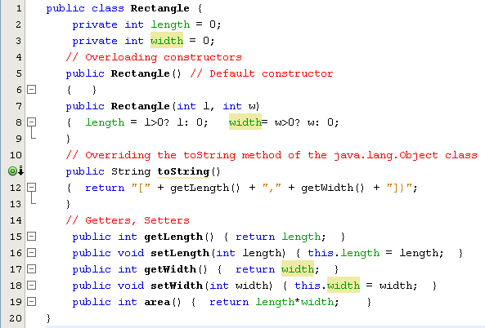
Inheritance…

Slide 10
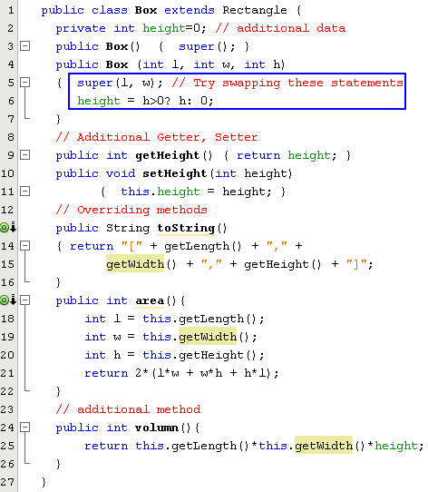
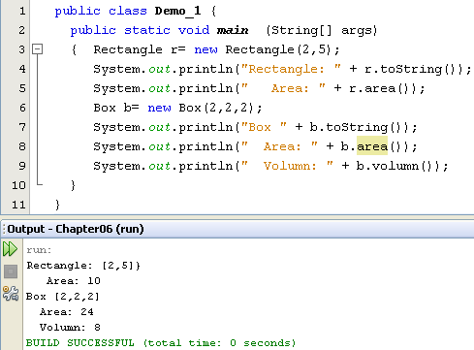
Inheritance…

Slide 11
Session 05 - Interface and Inheritance
Notes:
Kế thừa:
Không cho phép kế thừa lớp khởi tạo, phải gọi lớp khởi tạo super();
- Tp puclic->protect
protect->private
Private ko cho kế thừa
- Phương thức ghi đè bị ghi đè ở lớp dẫn xuất

Slide 12
Overriding and Hiding Methods (1)
Overriding a method: An instance method in a subclass with the same signature (name, plus the number and the type of its parameters) and return type as an instance method in the superclass overrides the superclass's method.
  Use the @Override annotation that instructs the compiler that you intend to override a method in the superclass (you may not use it because overriding is default in Java).
Hiding a method: Re-implementing a static method implemented in super class
Session 05 - Interface and Inheritance

Slide 13
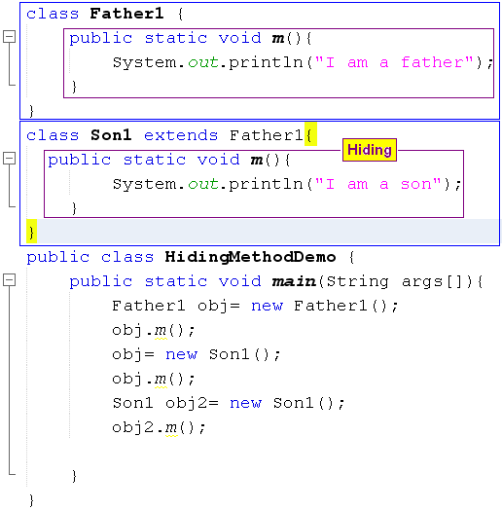

Overriding and Hiding Methods (2)
Session 05 - Interface and Inheritance
Notes:
- Hàm static không bị bị ghi đè khi kế thừa

Slide 14
Polymorphism
The ability of two or more objects belonging to different classes to respond to exactly the same message (method call) in different class-specific ways.
Inheritance combined with overriding facilitates polymorphism.
Session 05 - Interface and Inheritance

Slide 15
Polymorphism…)
Student
String name;
+ void print();
GraduateStudent
String underGraduateDegree;
+ GraduateStudent(String n, String ug) + void print();
UndergraduateStudent
String highSchool;
+ UndergraduateStudent(String n, String h) + void print ();
Session 05 - Interface and Inheritance
Notes:
Đa hình: Có nhiều phương thức giốn nhau gọi là đa luồng, khi gọi 1 phương thức theo nhiều cách khác nhau gọi là đa luồng

Slide 16
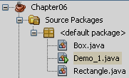
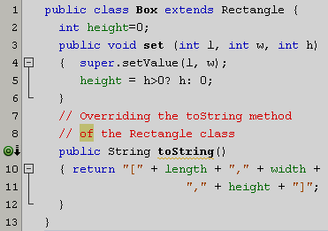
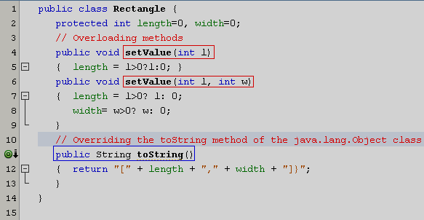

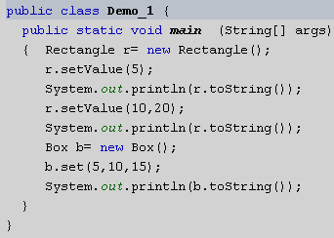
Overriding Inherited Methods
Overridden method: An inherited method is re-written
Overloaded methods: Methods have the same name but their parameters are different in a class
Session 4 - More on Classes and Nested Classes

Slide 17
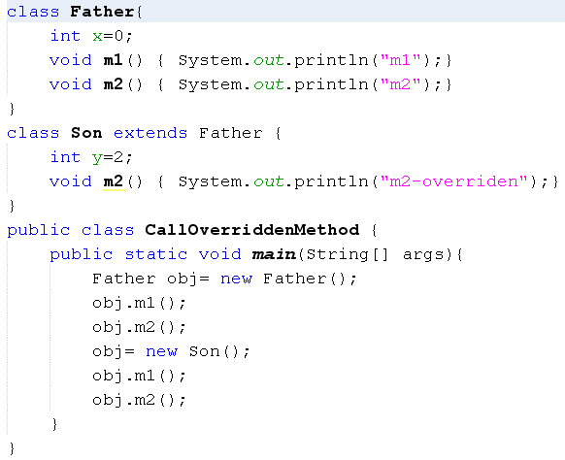
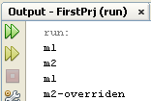
How Can Overridden Method be Determined?
Session 4 - More on Classes and Nested Classes

Slide 18
Interfaces
An interface is a reference type, similar to a class, that can contain only constants, initialized fields, static methods, prototypes (abstract methods, default methods), static methods, and nested types.
It will be the core of some classes
Interfaces cannot be instantiated because they have no-body methods.
Interfaces can only be implemented by classes or extended by other interfaces.
Session 05 - Interface and Inheritance

Slide 19
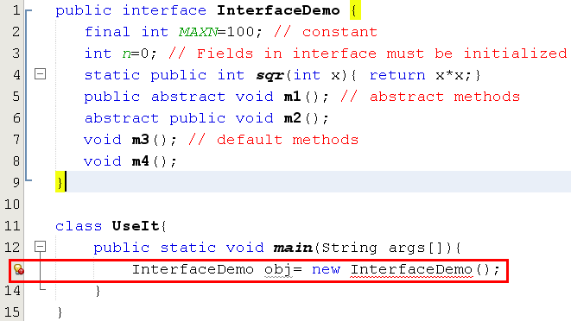
Interfaces…
Session 05 - Interface and Inheritance

Slide 20
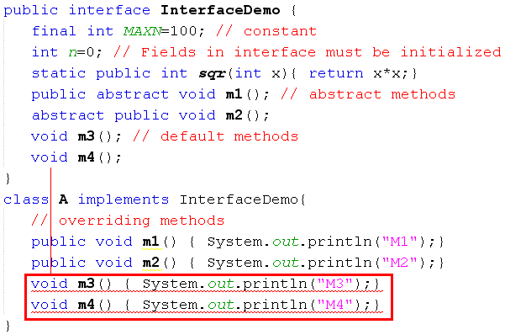
Interfaces…
m3(), m4() in A cannot implement m3(), m4() in InterfaceDemo, attempting to assign weaker access privileges, were public
Default methods of an interface must be overridden as public methods in concrete classes.
Session 05 - Interface and Inheritance
Notes:
assign : ấn định

Slide 21
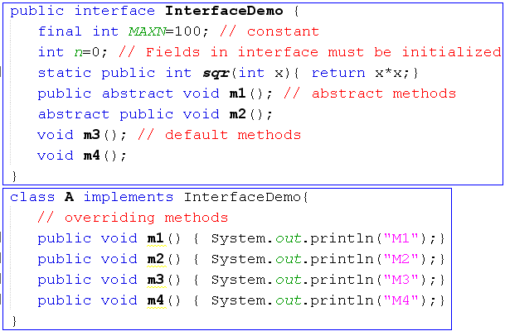
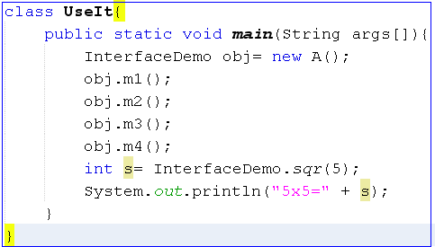
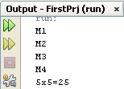
Interfaces…
Session 05 - Interface and Inheritance

Slide 22
Session 05 - Interface and Inheritance
Notes:
Các phương thưc có abs, không được xây dựn ở inerface mà phải xây dựng trong lớp dẫn xuất và để public
Chỉ các phương thức static mới dduwwocj xây dựng trong interf

Slide 23
Abstract Classes
Used to define what behaviors a class is required to perform without having to
provide an explicit implementation.
It is the result of so-high generalization
Syntax to define a abstract class
  public abstract class className{ ... }
It isn’t necessary for all of the methods in an abstract class to be abstract.
An abstract class can also declare implemented methods.
Session 05 - Interface and Inheritance
Notes:
Sử dụng để định nghĩa ra các hành vi của 1 lớp mà không cần cài đặt nội dung của lớp
Các phuwong thức trong lớp abs có thể là abs hoặc không
Có thể mô tả cài đặt các phuwuwowng thức ngay trong lớp abs

Slide 24
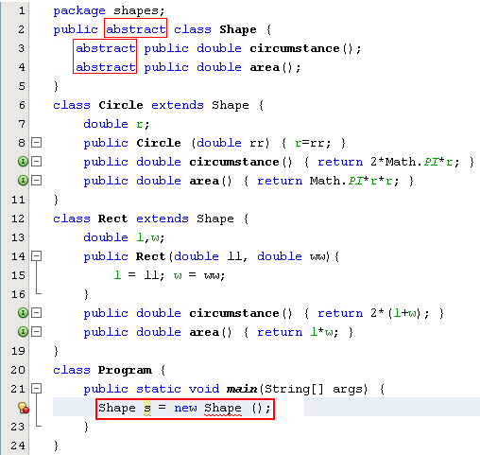
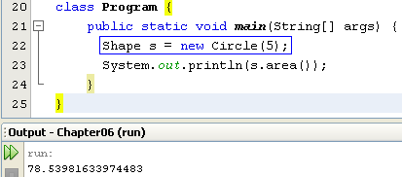
Abstract Classes…
Modified

Slide 25
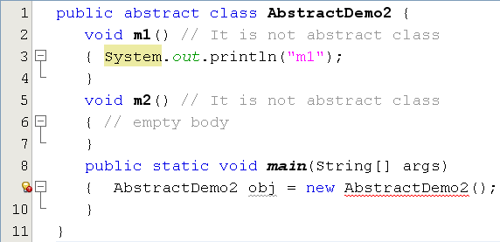
Abstract Classes…
This class have no abstract method but it is declared as an abstract class. So, we can not initiate an object of this class.
Notes:
D:\PhanHa\FPT\LTHÐT\PRO192-materials\02-examples\05-inheritance, interface, abstract class\3-abstract class\1-with abstract method

Slide 26
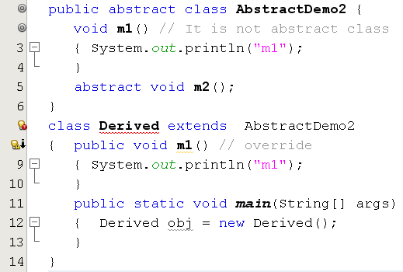
Abstract Classes…
Error. Why?

Slide 27
Session 05 - Interface and Inheritance
Notes:
Sử dụng để định nghĩa ra các hành vi của 1 lớp mà không cần cài đặt nội dung của lớp
Các phuwong thức trong lớp abs có thể là abs hoặc không
Có thể mô tả cài đặt các phuwuwowng thức ngay trong lớp abs
Không dduwwocj khởi tạo 1 đố tượng của lớp abstract, lớp abs được sử dụng thông qua lớp dẫn xuất
Phương thức nào là abs thì phải xây dựng ở trong lớp con (lớp kế thừa)

Slide 28
Implementing Abstract Methods
Derive a class from an abstract superclass, the subclass will inherit all of the superclass’s
features, all of abstract methods included.
To replace an inherited abstract method with
a concrete version, the subclass need merely override it.
Abstract classes cannot be instantiated
Session 05 - Interface and Inheritance

Slide 29
Anonymous Classes
Anonymous classes are classes which are not named but they are identified automatically by Java compiler.
Where are they? They are identified at initializations of interface/abstract class object but abstract methods are implemented as attachments.
Why are they used?
Enable you to make your code more concise.
Enable you to declare and instantiate a class at the same time.
They are like local classes except that they do not have a name.
Use them if you need to use a local class only once.
Session 4 - More on Classes and Nested Classes

Slide 30
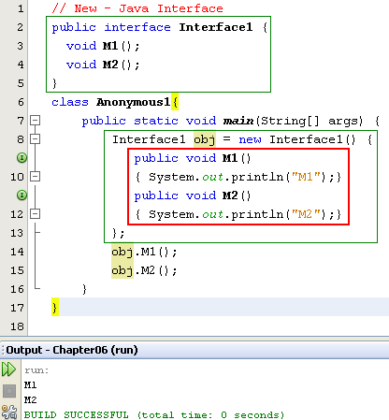

Anonymous Class…
Anonymous class.
Class name is given by the compiler:
ContainerClass$Number

Slide 31
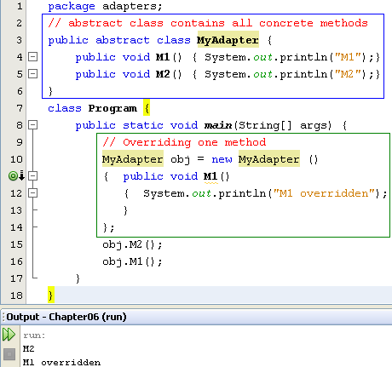
Anonymous Class…
Concrete methods but they can not be used because the class is declared as abstract one.
The abstract class can be used only when at least one of it’s methods is overridden
Anonymous class is a technique is commonly used to support programmer when only some methods are overridden only especially in event programming.
Notes:
Concrete: cụ thể
Sử dụng khi muốn ghi đè phương thức không phải abs, ví dụ phương thwucs M1 là phương thức cụ thể trong asb nhưng không dduwwocj sử dụng khi gọi mà có thể bị ghi đè

Slide 32

Enum Types
An enum type is a special data type that enables for a variable to be a set of predefined constants.
We use enum types any time you need to represent a fixed set of named-constants (uppercase).
New/ Java Enum
Session 4 - More on Classes and Nested Classes

Slide 33
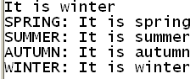
Enum Type simple example
enum Season { SPRING, SUMMER, AUTUMN, WINTER }
class Main {
static void fun(Season x)
{switch(x)
{case SPRING: System.out.println("It is spring"); break;
case SUMMER: System.out.println("It is summer"); break;
case AUTUMN: System.out.println("It is autumn"); break;
case WINTER: System.out.println("It is winter");
}
}
public static void main(String[] args) {
Season x = Season.WINTER; fun(x);
for(Season y: Season.values()) {
System.out.print(y + ": "); fun(y);
}
System.out.println();
}
}
Session 4 - More on Classes and Nested Classes

Slide 34
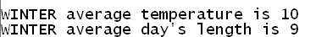
Enum Type with parameter constructor
enum Season {
SPRING(25, 11), SUMMER(32, 13), AUTUMN(23, 10), WINTER(10, 9);
private final int avgTemp, dayLength;
Season(int x, int y) {
avgTemp = x; dayLength = y;
}
public void display() {
System.out.println(this + " average temperature is " + avgTemp);
System.out.println(this + " average day's length is " + dayLength);
}
}
class Main {
public static void main(String[] args) {
Season x = Season.WINTER;
x.display();
System.out.println();
}
}
Session 4 - More on Classes and Nested Classes

Slide 35
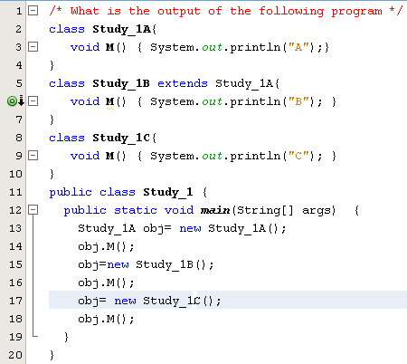
Test
a) ABC
b) AAC
c) ABA
d) Compile-time error
Study_1A and Study_1C are inconvertible
Notes:
A B lỗi

Slide 36
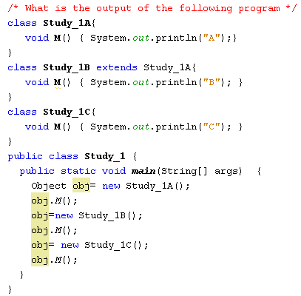
Test
a) ABC
b) AAC
c) ABA
d) Compile-time error
The java.lang.Object class does not have the M() method
Notes:
Không có phương thức M ở lớp object
Nếu lớp object có nó mới ghi đè

Slide 37
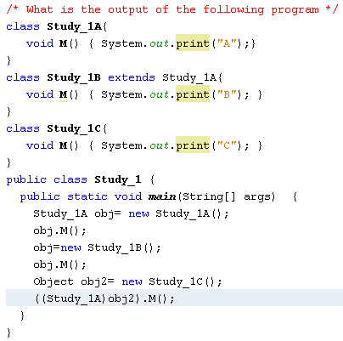
Test
a) ABC
b) AAA
c) ABA
d) None of the others
AB and a ClassCastException
Notes:
AB lỗi//Không cho convert 1 đối tượng sang kiểu đối tượng

Slide 38
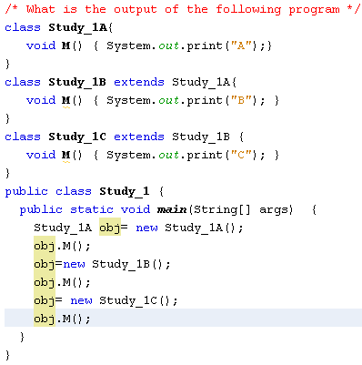
Test
a) AAA
b) ACB
c) None of the others
d) ABC
Notes:
ABC

Slide 39
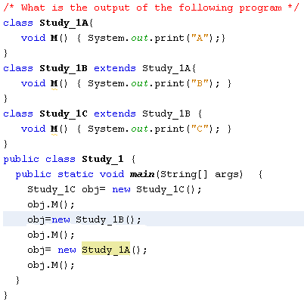
Test
a) ABC
b) AAA
c) ABA
d) None of the others
Compile-time error
( Type conformity violation)
Notes:
C và lỗi

Slide 40
class study_1A {
void M(){System.out.println("A");
}}
class study_1B extends study_1A{
void M(){System.out.println("B");
}}
class study_1C extends study_1B{
void M(){System.out.println("C");
}}
public class Inheritace {
/**
* @param args the command line arguments
*/
public static void main(String[] args) {
// TODO code application logic here
study_1C t=new study_1C();
t.M();
t=new study_1B();
t.M();
t=new study_1A();
t.M();
}
}
Session 05 - Interface and Inheritance

Slide 41
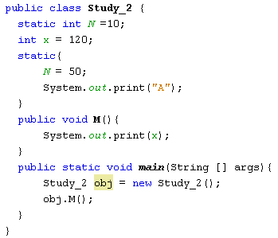
Test
a) 120
b) 120A
c) None of the others
d) A120
Notes:
A120

Slide 42
public static void main(String[] args) {
// TODO code application logic here
System.out.println("main");
Inheritace t=new Inheritace();
System.out.println("after instan");
t.M();
}
Session 05 - Interface and Inheritance
Notes:
A main after 120

Slide 43
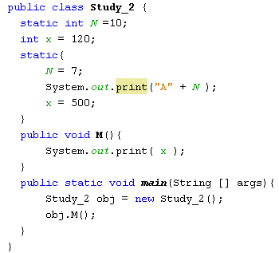
Test
a) A7500
b) 500A7
c) 500
d) None of the others
Compile-time error
( static code can not access instance variables)

Slide 44
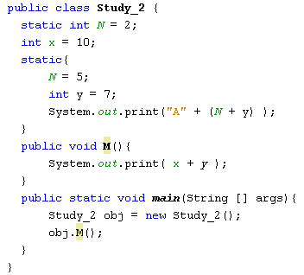
Test
a) A1210
b) 10A12
c) 17
d) None of the others
Compile-time error
( The y variable is out of scope)

Slide 45
public class Inheritace {
static int N=10;
int x=120;
static { N=5;
System.out.println("A"+(N+5));
}
public void M(){System.out.println(x);}
Session 05 - Interface and Inheritance

Slide 46
Summary
Benefits of OO implementation: Inheriatance ans Polymorphism
Working with Interfaces.
Working with Abstract Methods and Classes.
Anonymous Classes
Enum Type
Session 05 - Interface and Inheritance

Slide 47
Lớp ArrayList (java.util.)
  add,set, remove,…
  Is Genericc lass:
  ArrayList<T> - tập các đối tượng có kiểu T
  exam
    ArrayList<people> nvs =new ArrayList<people>();
    nvs.add(new people(1001));
    nvs.add(new peoplei(1015));
    nvs.add(new people(1022));
Session 05 - Interface and Inheritance

Slide 48
  people nv=nvs.get(2);//
  int i = nv.size();
Session 05 - Interface and Inheritance

Slide 49
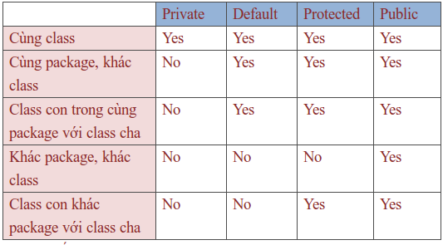
Session 05 - Interface and Inheritance

